Slide 1

Project 1: Data Scientist’s Dilemma: Finding the Optimal State for Career and Quality of Life
Renato Barbosa, Mia Serrano-Salow, Jalaine Pruitt, Nelson Velasco
UM Data Analytics Boot Camp
November 6th, 2023

Slide 2
Our Motivation
The job market for the tech industry, more specifically for data scientists, has expanded drastically in the last decade. Due to such high demand in the field, job opportunities have become more competitive, making it more difficult to secure positions and stand out from the crowd. As a result, data scientists are increasingly considering not only their potential earnings but also the overall lifestyle and quality of life in the state where they choose to settle. In this presentation, we'll explore the best states for data scientists based on both average salary and quality of life factors, helping you make an informed decision about where to build your career and call home.

Slide 3
Key Research Questions
What are the top 5 best and top 5 worst states in the U.S. for a data scientist to live in terms of median annual salary?
What are the top 5 most expensive states to live in and the top 5 least expensive states to live in?
How does the average data scientist salary after tax compare to that of other professions in each state? Which are the most positive and negative states?
What is the best state to live in as a data scientist based on all this information?
What recommendations can be made to individuals working in the data science field to navigate the balance between job opportunities and housing affordability in urban areas?

Slide 4

Our Core Hypothesis
We hypothesize that the earnings for data scientists is going to be more than the earning of other professions.

Slide 5

Data Exploration and Clean-Up

Slide 6
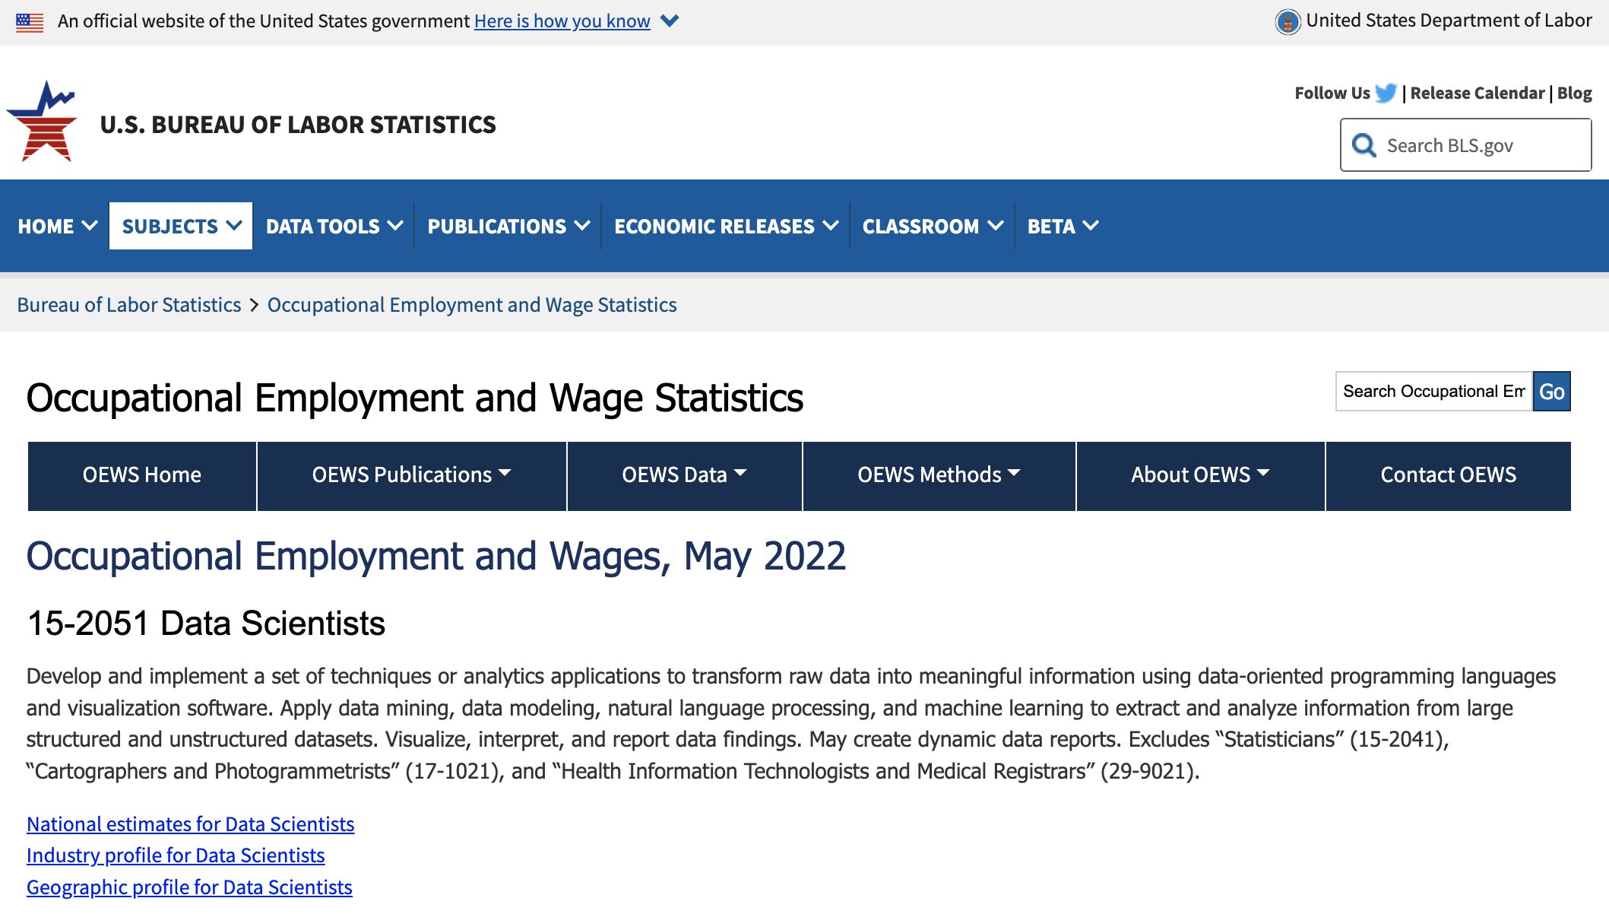
Where is our data scientist national average wages data from?
https://www.bls.gov/oes/current/oes152051.htm

Slide 7
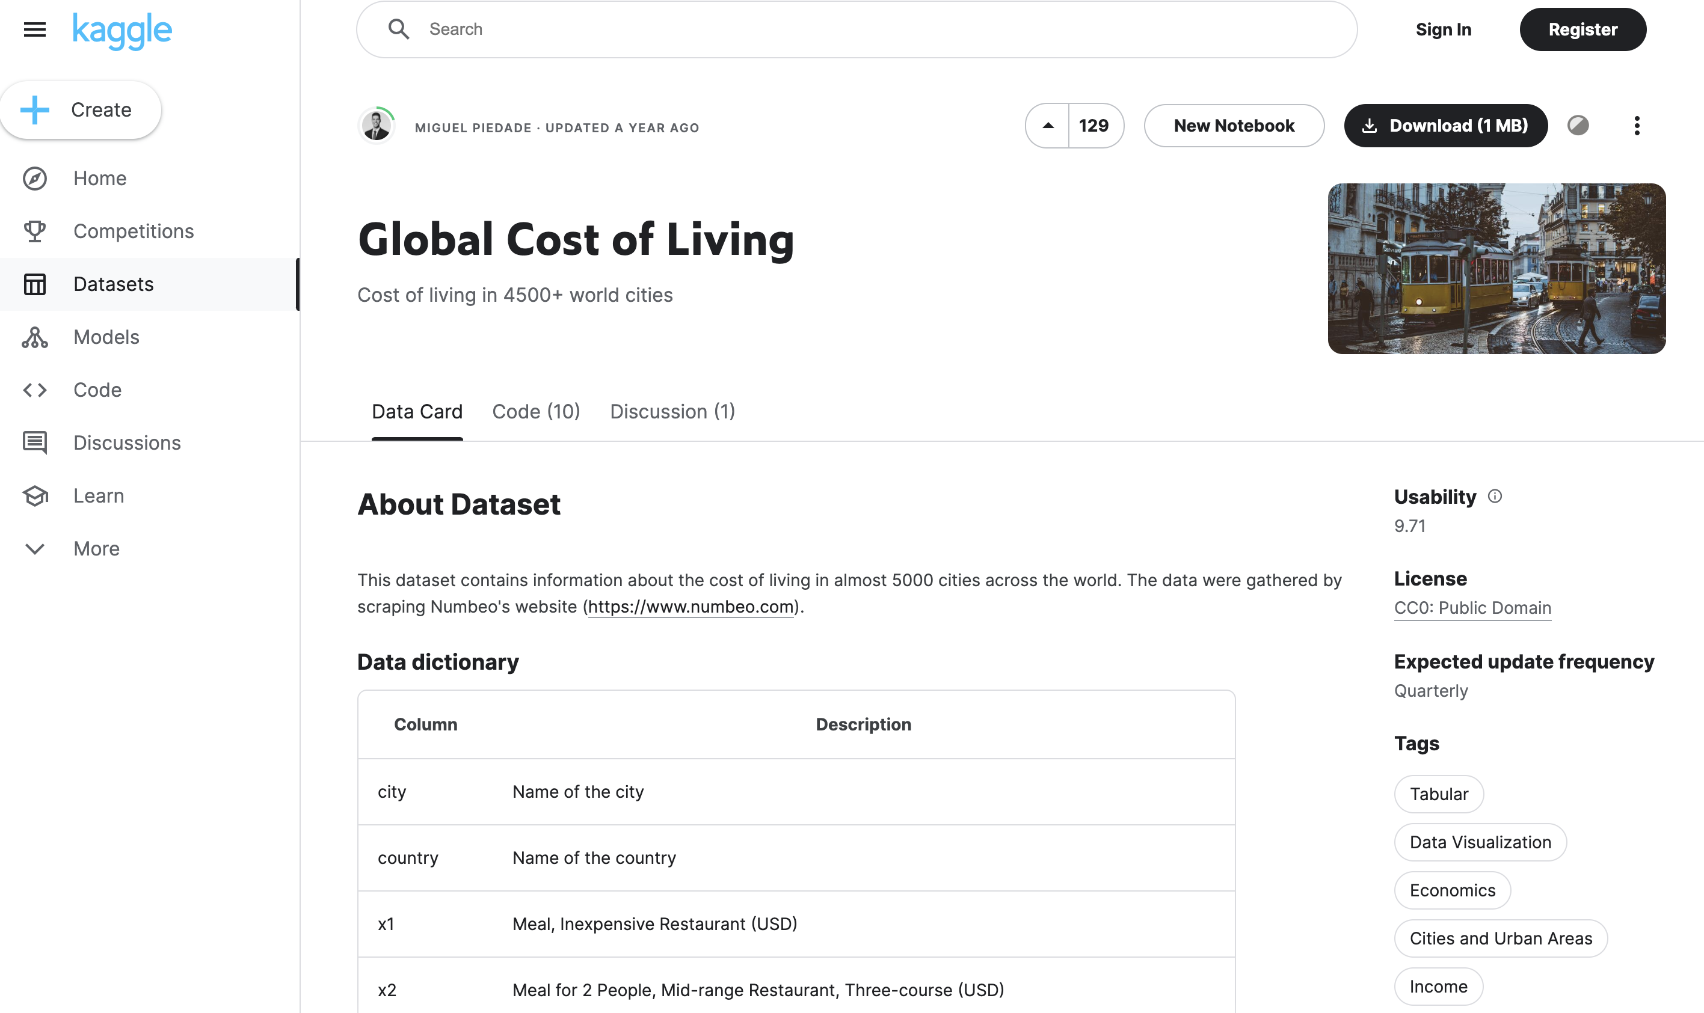
Where is our cost of living data from?
https://www.kaggle.com/datasets/mvieira101/global-cost-of-living/data

Slide 8
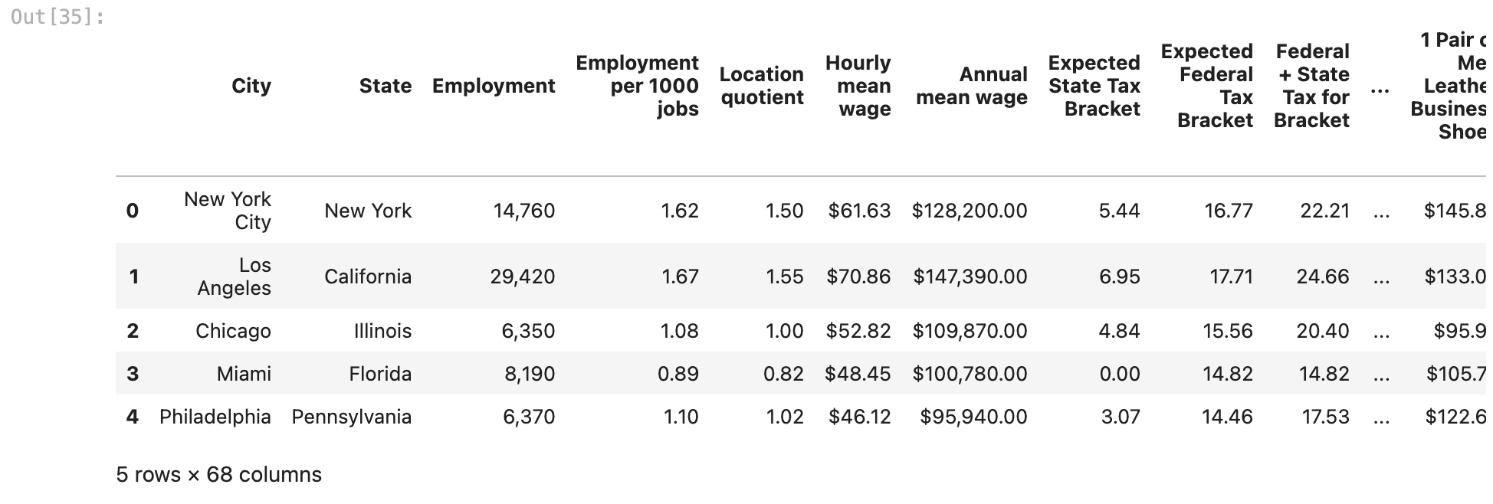
Snippet of data scientist wage data before cleaning

Slide 9
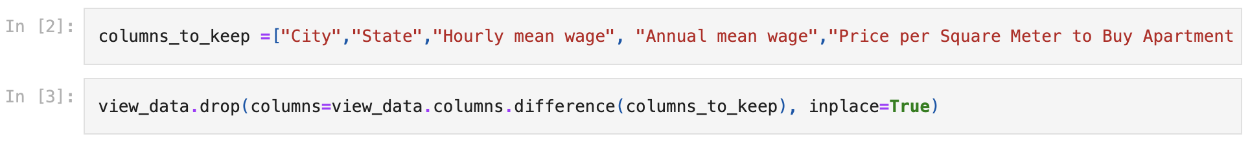
What did we do to clean up?
Filtered out unnecessary columns that did not pertain to our research
Filtered out null values

Slide 10
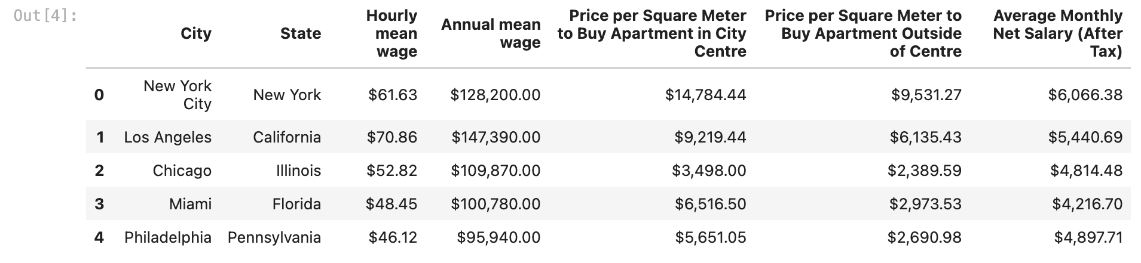
Snippet of data after cleaning

Slide 11
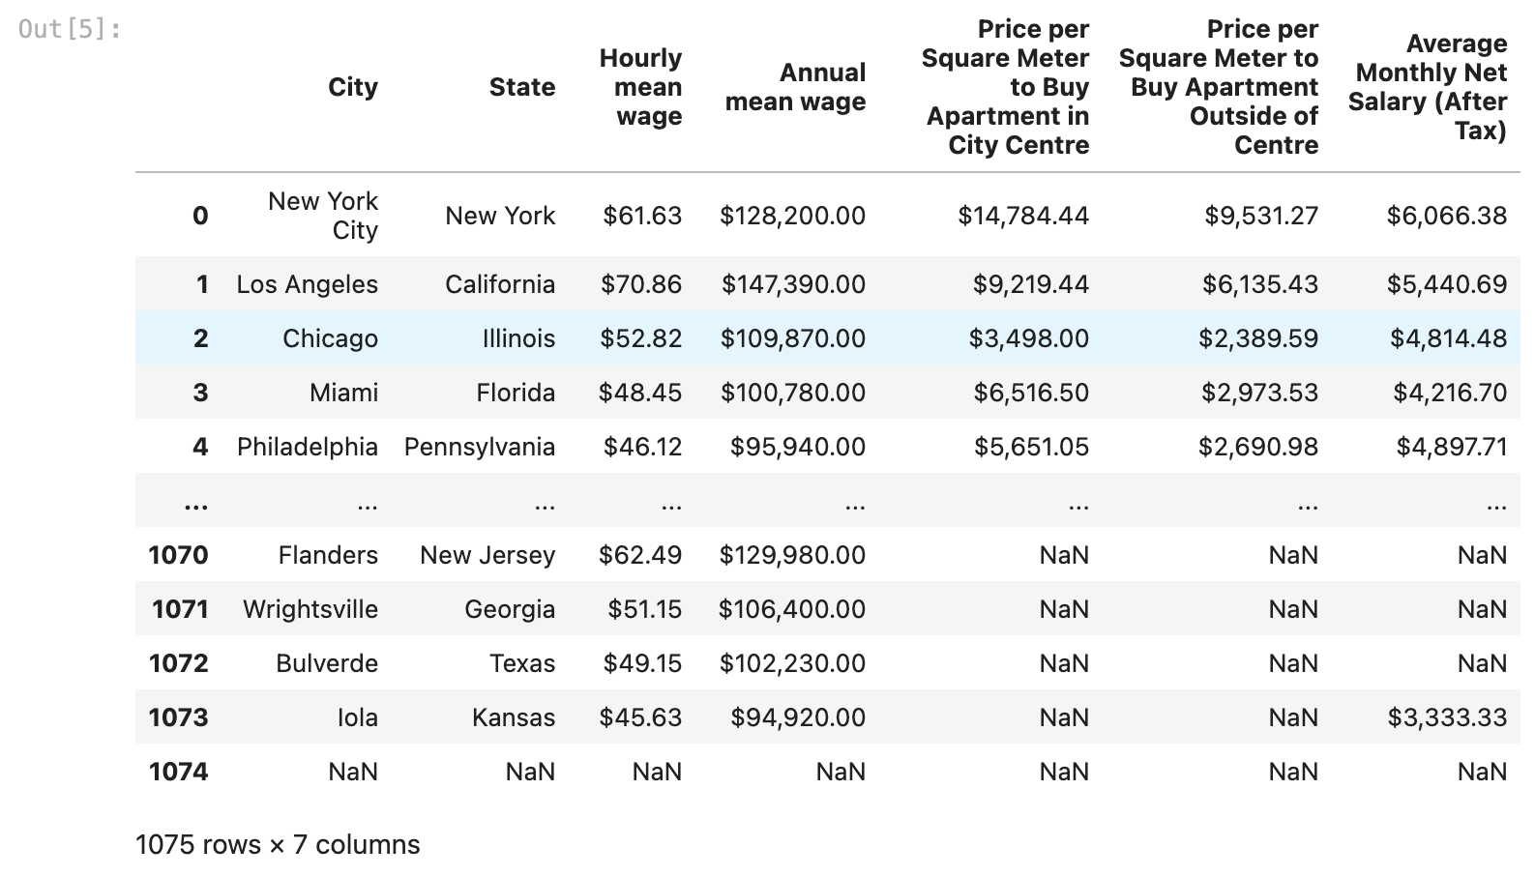
Snippet of cost of living data before cleaning

Slide 12
What did we do to clean up?
Filtered out null values
Most of the data in this data set already contained data that we needed, so the clean-up process was shorter.

Slide 13
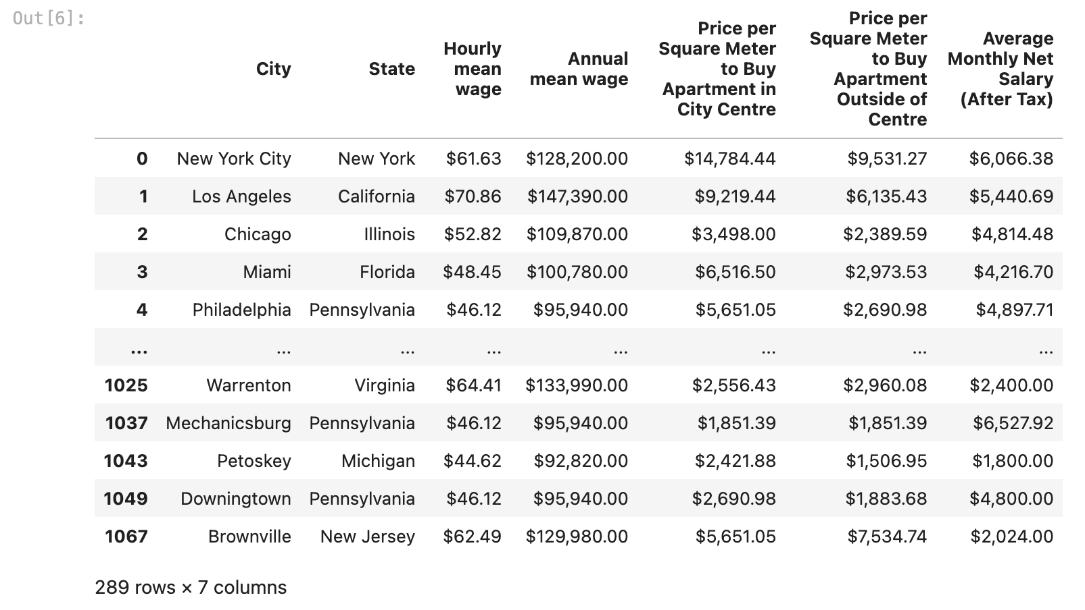
Snippet of data after cleaning

Slide 14

Data Analysis

Slide 15
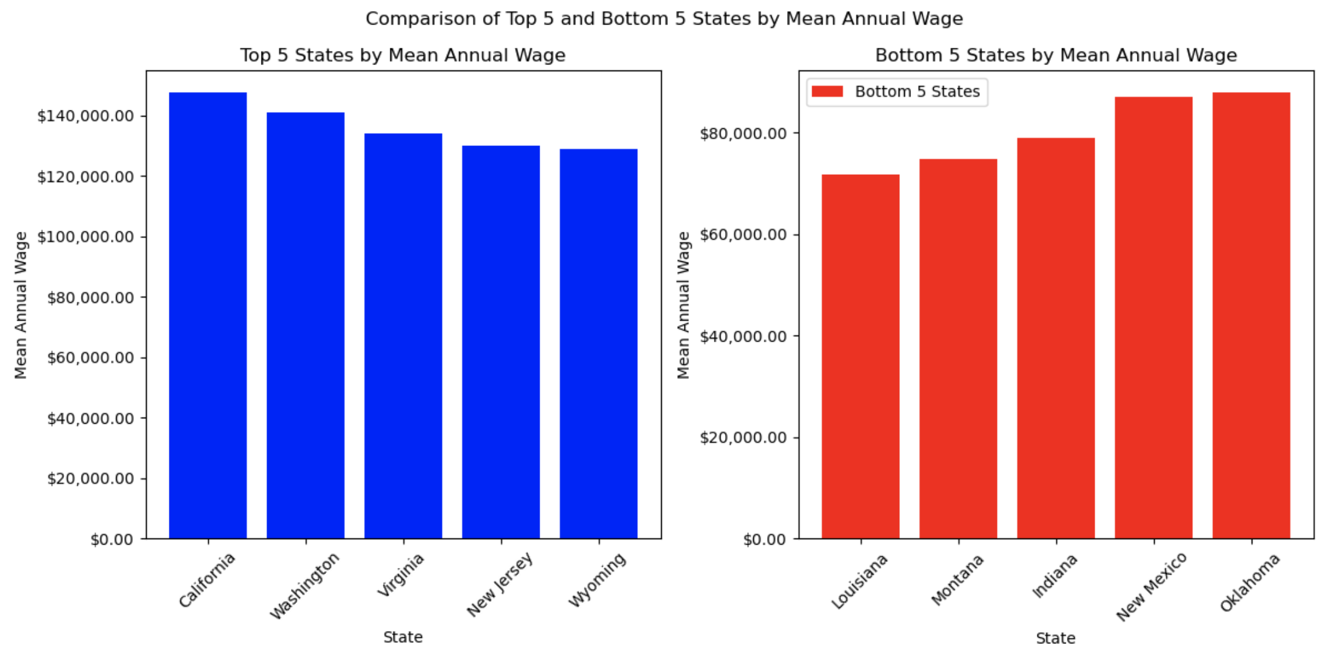
What are the top 5 best and worst states to live in based on mean wage?

Slide 16
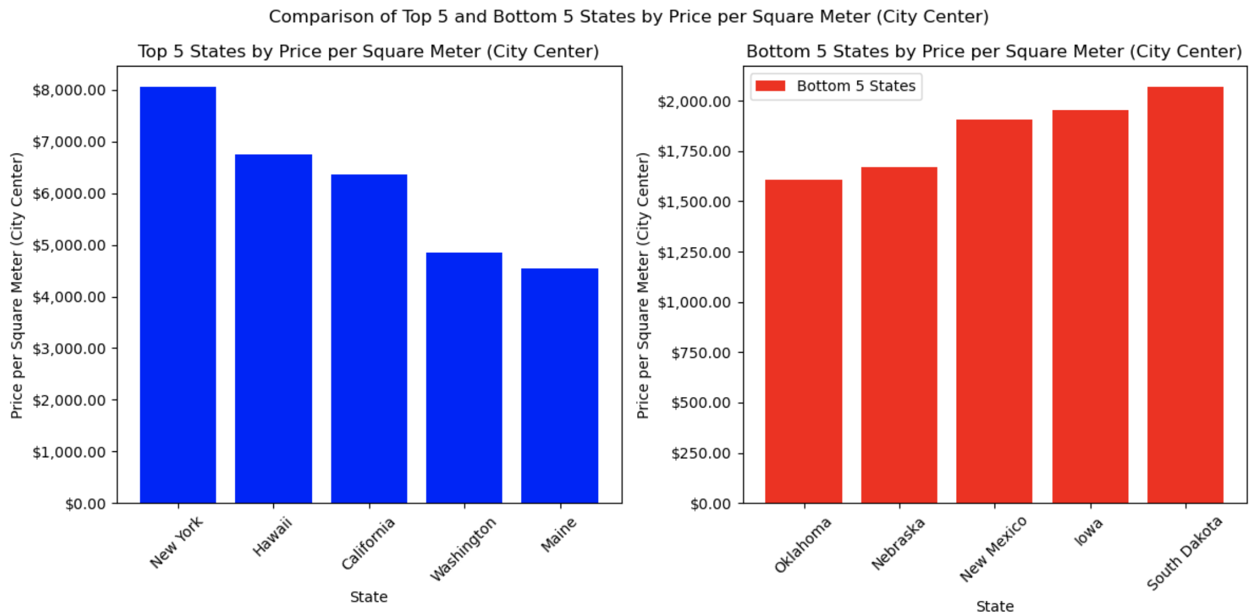
What are the top 5 most expensive and least expensive states (urban area)?

Slide 17
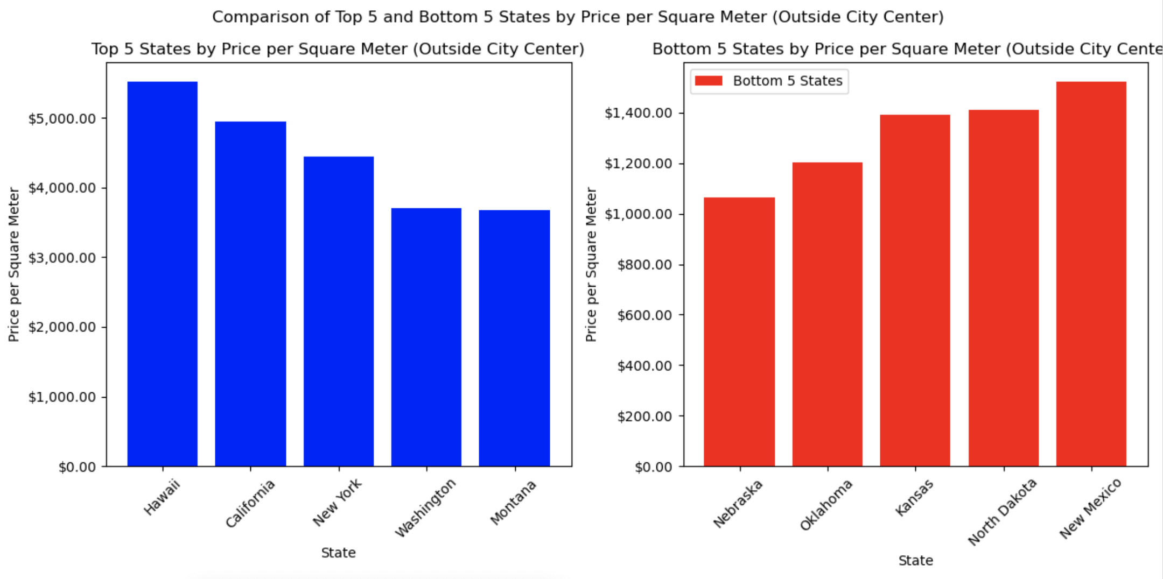
What are the top 5 most expensive and least expensive states (suburban area)?

Slide 18
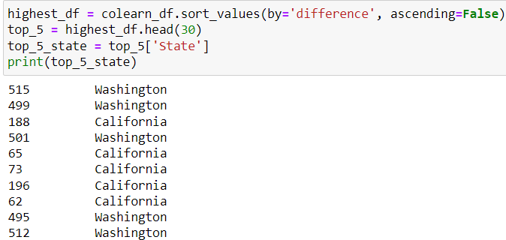
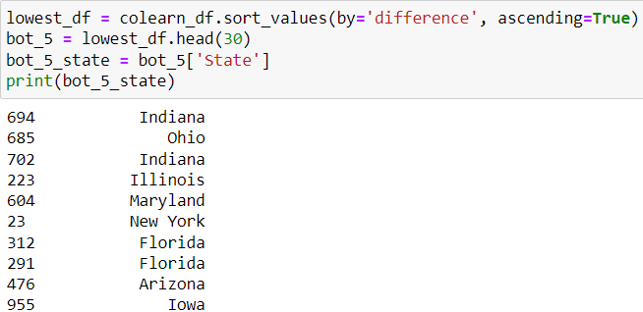
Data Scientist Salary vs. Other Professions Salary
Individual values at the city level
Top 5 Highest Difference
Bottom 5 Lowest Difference

Slide 19
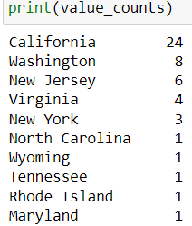
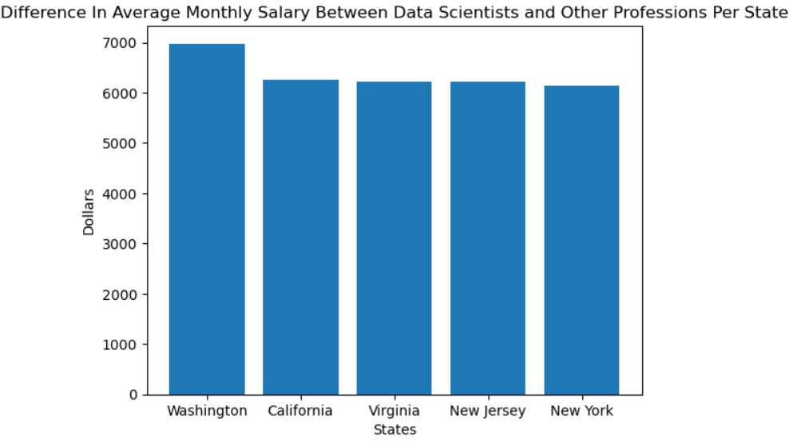
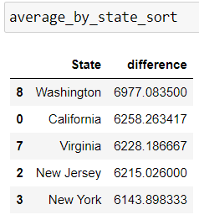
Top 5 State Count and Average Salary Difference

Slide 20
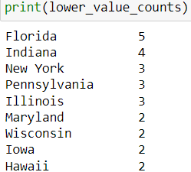
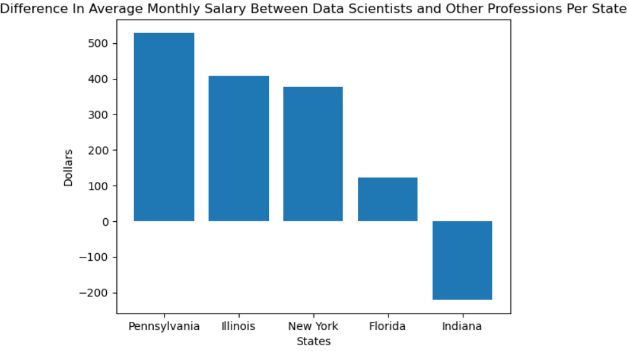
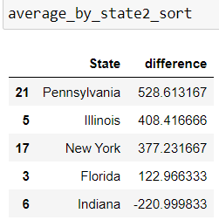
Bottom 5 State Count and Average Salary Difference

Slide 21
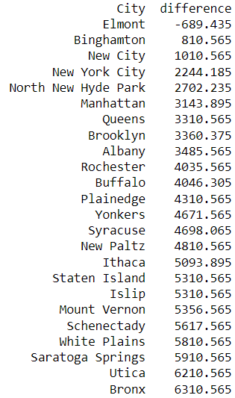


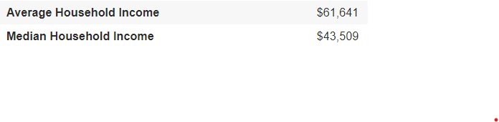
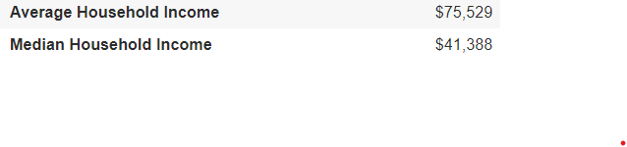

What’s Happening in New York?
Elmont
New City
Utica
Bronx
Source:

Slide 22
Conclusion: Best State to Live In
We have concluded that there are two states that are the best to live in if you are a data scientist. These states are California and Washington. We have concluded this because although they are both two of the most expensive states to live in inside and outside city centers, their high salaries outweighs the cost of living.

Slide 23
What recommendations can be made to individuals working in the data science field to navigate the balance between job opportunities and housing affordability in urban areas?
A few recommendations to individuals working in the data science field to navigate the balance between job opportunities and housing affordability in urban areas would be to research the city, consider remote jobs, budgeting, and salary negotiation.
You should research the city before considering accepting a job in the data science industry. You want to research the cost of living and job demand. You may want to consider remote job opportunities to save money. You can cut costs on transportation and groceries. Gas prices are steadily increasing. By working remotely, you can eat at home versus eating out. Working remote can also eliminate you driving a long distance to work. Driving an hour or longer to and from work depending on traffic could cause stress. Especially on days when you are mentally exhausted.
Another recommendation is budgeting. Make sure you prepare a monthly budget to ensure you are not living above your means. Minimize expenses as much as possible. Have a strict budget and stick to it. Lastly, negotiate your salary. You never know until you ask. Persuade the company that you add value and have the qualities and expertise to perform the job.

Slide 24

Limitations/Unanticipated Insights

Slide 25
While researching the topic we chose and attempting to collect data, we were unable to find an accessible API for our data set from the Bureau of Labor Statistics. Because of this, we made the collective decision to not use an API for our project.
Our analysis based on state data could be inaccurate due to some cities’ high standard deviation of data.
More time = more research
A larger window of time for this project could have allowed for more in-depth research, contributing to the accuracy of data.

Slide 26

Questions?

